Slide 1
Kelompok7
Indri Yani Berutu 535200078
Muhammad Habib Riski 535200078
Krisna Wijaya Liu 535200077
Eiji Yoshikawa 535200063
Devi Ayu Pramata Sari 535200087

Slide 2


Slide 3
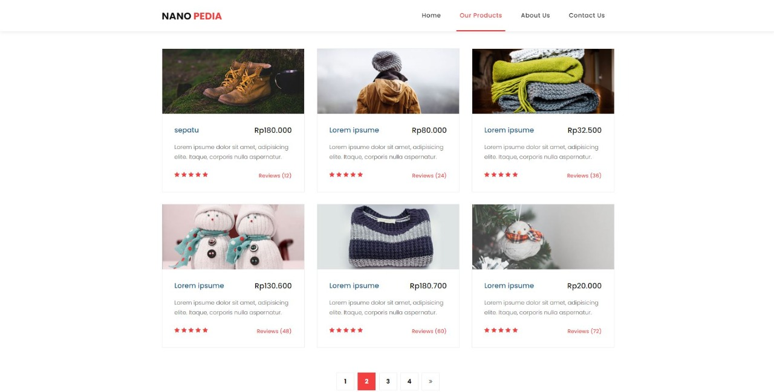

Slide 4


Slide 5


Slide 6
Thank You
Do you have any questions?

